Slide 1
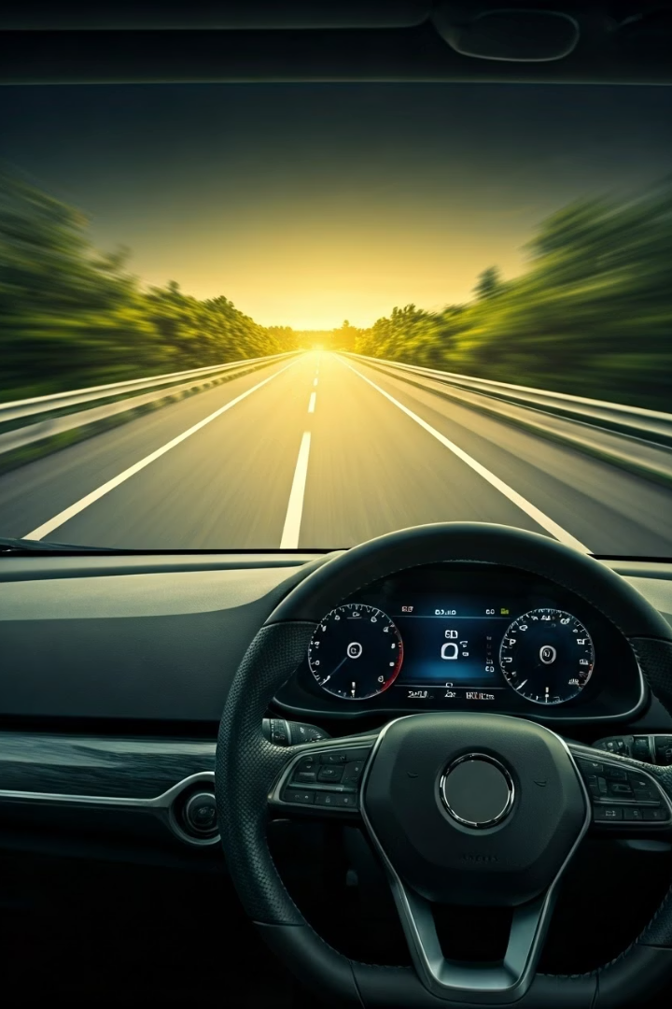
Road Lane Detection System Using Advanced Computer Vision
A comprehensive approach to enhancing driving safety through real-time video analytics and deep learning.
Team:
Riya Srivastava Rudra Tomar
E22CSEU0685 E22CSEU0531

Slide 2
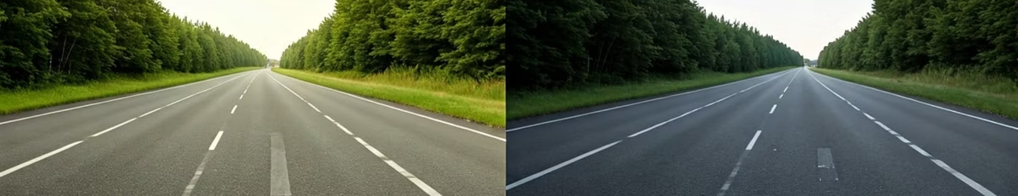




Project Overview
Lane Detection
Object Detection
Automated system using image processing techniques
Real-time identification using YOLOv8 model
Enhanced Awareness
Scalable Solution
Integrated visualization for improved road safety
Designed for autonomous vehicles and ADAS

Slide 3
Technologies & Tools
Programming
Deep Learning
Image Processing
Python
YOLOv8 model
Gaussian Blur
OpenCV
Ultralytics YOLO
Canny Edge Detection
PyTorch
Perspective Transformation
HLS Color Space

Slide 4
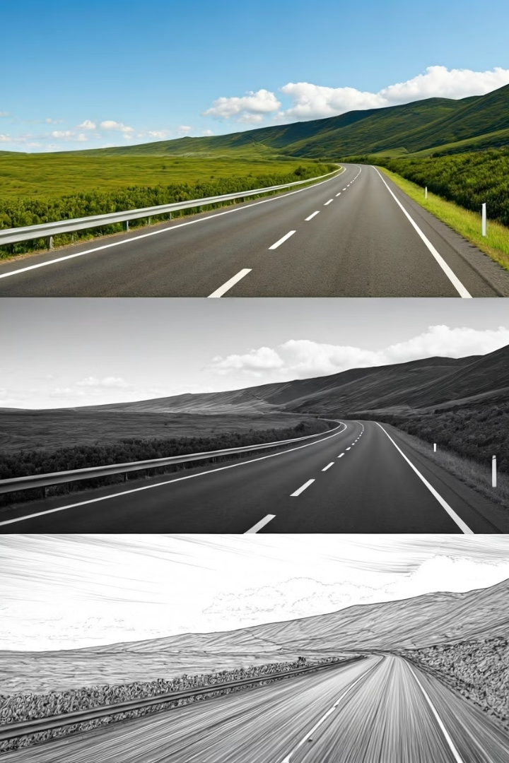
Image Preprocessing
Color Space Conversion
Convert to HLS color space to enhance lane visibility under different lighting conditions.
Noise Reduction
Apply Gaussian blur to minimize false edge detection.
Edge Detection
Use Canny algorithm to highlight lane boundaries.

Slide 5
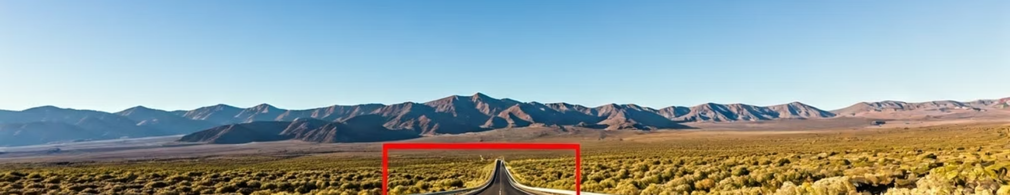



Region of Interest Extraction
Masking
Perspective Transformation
Points Definition
Isolate road area and ignore irrelevant regions
Warp to bird's-eye view for better detection
Define source and destination points for alignment

Slide 6








Lane Detection and Tracking
Histogram Analysis
Sliding Window
Analyze lower half of image to locate lane lines
Place windows along lanes to track non-zero pixels
Frame Update
Polynomial Fitting
Track and update lane positions across video frames
Fit smooth curves to detected lane points

Slide 7
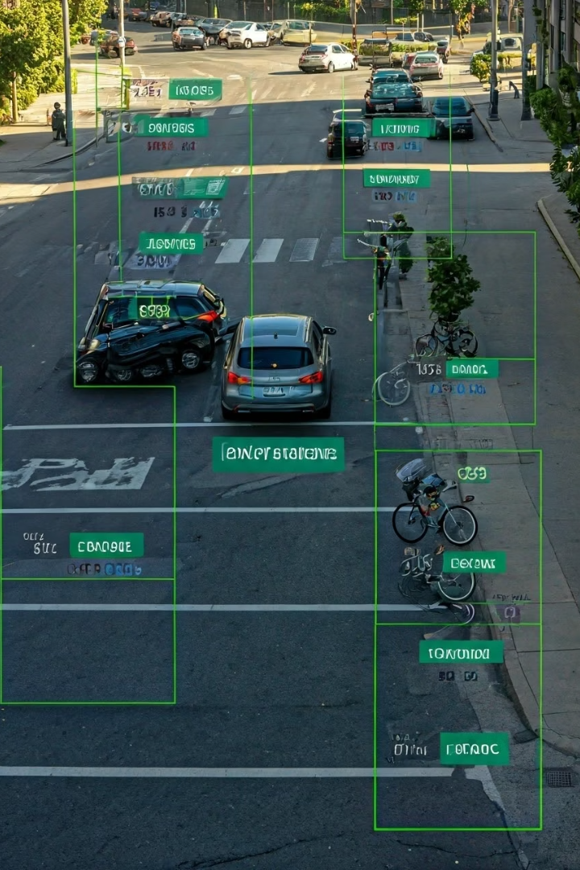
Object Detection System
YOLOv8 Implementation
Frame Processing
Pass each video frame through YOLOv8 to detect and classify objects.
Load pre-trained model with Ultralytics package for real-time object detection.
Detection Output
Generate bounding boxes, class labels, and confidence scores for vehicles and pedestrians.

Slide 8






System Integration
Unified Visualization
Combined lane and object detection display
Process Synchronization
Temporal alignment of detection systems
Video Processing
Frame-by-frame analysis and overlay

Slide 9
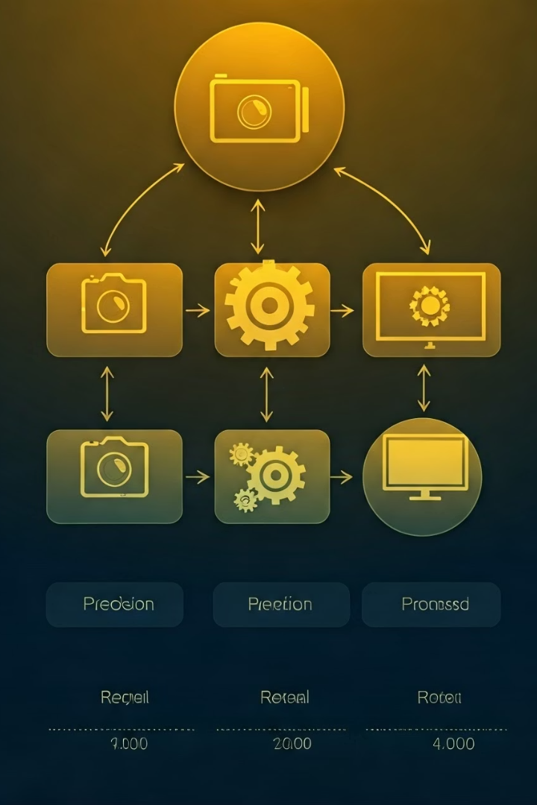




Solution Approach
Data Acquisition
Collect and pre-process video footage with annotations
Feature Extraction
Apply image processing and YOLOv8 for detection
Detection Integration
Combine lane and object detection in unified display
Evaluation
Assess using precision, recall, and mAP metrics

Slide 10
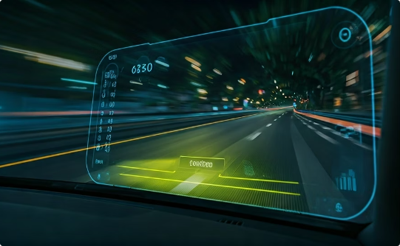
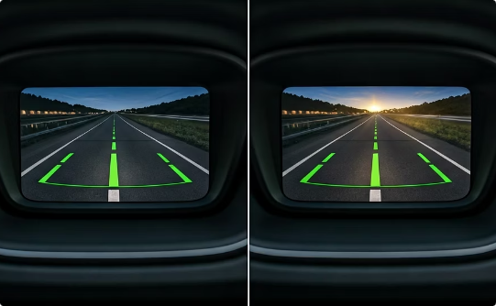
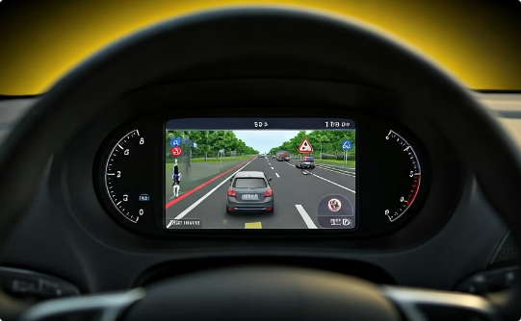
Key Findings & Applications
High Accuracy
Lighting Adaptability
Improved Awareness
YOLOv8 achieved excellent real-time object detection performance.
Image processing techniques enhanced lane visibility across various conditions.
Combined system provides comprehensive view of lane boundaries and objects.

Slide 11
THANKYOU

